Slide 1
Greedy methods: Activity selection problem
Session 11
Henry Lucky, S.Kom. M.Kom.

Slide 2
Outline Materials
Session 11
Activity-selection problem
Recursive greedy algorithm
Iterative greedy algorithm
Elements of greedy strategy

Slide 3
Learning outcomes
LO 1: Explain fundamental concept of analysis algorithms
LO 2: Apply algorithm techniques and methods
LO 3: Solve a problem using specific algorithm.
LO 4: Compare several algorithm design methods

Slide 4
Activity selection problem
Definition
The activity selection problem is a classic optimization problem that involves selecting a maximum-size subset of mutually compatible activities from a given set of activities, each with a start time and finish time.
The objective is to choose the largest possible set of activities that do not overlap in time.

Slide 5
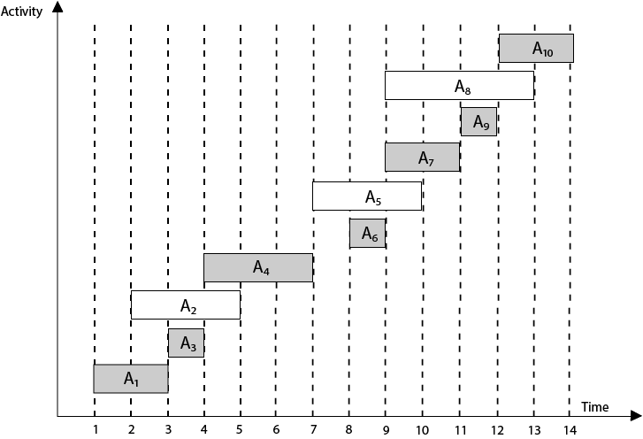
Activity selection problem
Definition

Slide 6
Activity selection problem
Definition
Formally, let A = {a1, a2, ..., an} be a set of n activities, where each activity ai is characterized by its start time si and finish time fi, such that 0 ≤ si < fi for all i.
The goal is to find a subset S ⊆ A, such that no two activities in S overlap in time, and |S| (the cardinality of S) is maximized.
In other words, we want to select activities in such a way that they do not conflict with each other, and we aim to find the largest possible number of non-overlapping activities.

Slide 7
Activity selection problem
Definition
The activity selection problem can be solved efficiently using greedy algorithms, such as the greedy activity selection algorithm, which sorts the activities based on their finish times and selects the activities that are compatible with the previously selected activities.
The greedy approach provides an optimal solution for this problem.
We’ll develop a recursive greedy algorithm to solve the activity-selection problem.
Finally, we’ll complete the process of developing a greedy solution by converting the recursive algorithm to an iterative one.

Slide 8
Recursive greedy algorithm
Let’s see a straightforward, recursive procedure to solve the activity-selection problem.
The procedure RECURSIVE-ACTIVITY-SELECTOR on the following page takes the start and finish times of the activities, represented as arrays s and f, the index k that defines the subproblem Sk it is to solve, and the size n of the original problem.
It returns a maximum-size set of mutually compatible activities in Sk.
The procedure assumes that the n input activities are already sorted by monotonically increasing finish time.

Slide 9
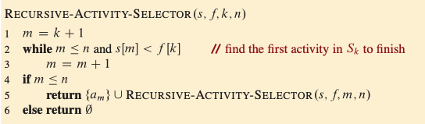
Recursive greedy algorithm

Slide 10
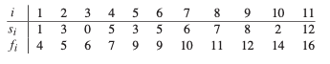
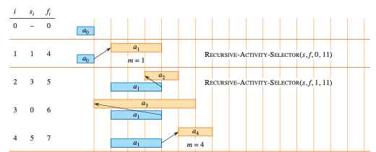
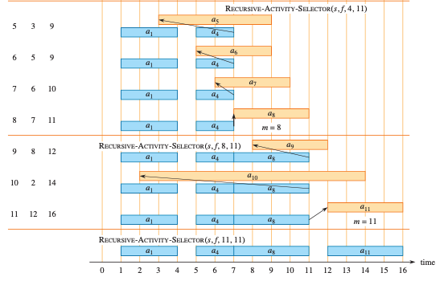
Recursive greedy algorithm

Slide 11
Recursive greedy algorithm

Slide 12

Recursive greedy algorithm
Assuming that the activities have already been sorted by finish times, the running time of the call RECURSIVE-ACTIVITY-SELECTOR(s, f, 0, n) is $Θ(n)$.
To see why, observe that over all recursive calls, each activity is examined exactly once in the while loop test of line 2.
In particular, activity is examined in the last call made in which k<i.

Slide 13
iterative greedy algorithm
The recursive procedure can be converted to an iterative one because the procedure RECURSIVE-ACTIVITY-SELECTOR is almost “tail recursive”: it ends with a recursive call to itself followed by a union operation.
It is usually a straightforward task to transform a tail-recursive procedure to an iterative form.
In fact, some compilers for certain programming languages perform this task automatically.
The procedure GREEDY-ACTIVITY-SELECTOR is an iterative version of the procedure RECURSIVE-ACTIVITY-SELECTOR.
It, too, assumes that the input activities are ordered by monotonically increasing finish time. It collects selected activities into a set and returns this set when it is done.

Slide 14
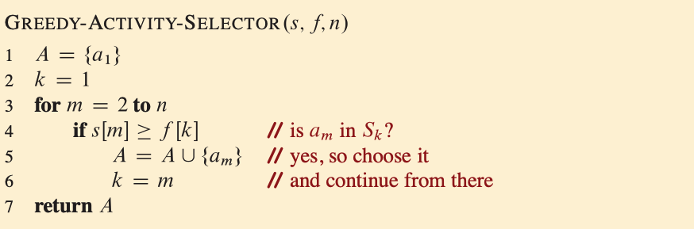
iterative greedy algorithm

Slide 15

iterative greedy algorithm
Like the recursive version, GREEDY-ACTIVITY-SELECTOR schedules a set of n activities in $Θ\left(n\right)$ time, assuming that the activities were already sorted initially by their finish times.

Slide 16
Elements of greedy strategy
A greedy algorithm obtains an optimal solution to a problem by making a sequence of choices.
At each decision point, the algorithm makes the choice that seems best at the moment.
This heuristic strategy does not always produce an optimal solution, but as in the activity-selection problem, sometimes it does.
This section discusses some of the general properties of greedy methods.

Slide 17
Elements of greedy strategy
You can design greedy algorithms according to the following sequence of steps
Cast the optimization problem as one in which you make a choice and are left with one subproblem to solve.
Prove that there is always an optimal solution to the original problem that makes the greedy choice, so that the greedy choice is always safe.
Demonstrate optimal substructure by showing that, having made the greedy choice, what remains is a subproblem with the property that if you combine an optimal solution to the subproblem with the greedy choice you have made, you arrive at an optimal solution to the original problem.
How can you tell whether a greedy algorithm will solve a particular optimization problem? No way works all the time, but the greedy-choice property and optimal substructure are the two key ingredients.

Slide 18
Elements of greedy strategy
Greedy choice property
The greedy-choice property states that a globally optimal solution can be reached by making locally optimal choices at each step of the algorithm.
To establish the greedy-choice property, we need to demonstrate/prove that at each step, choosing the locally optimal solution will not lead to a suboptimal or incorrect final solution.
You can usually make the greedy choice more efficiently than when you have to consider a wider set of choices.
For example, in the activity-selection problem, assuming that the activities were already sorted in monotonically increasing order by finish times, each activity needed to be examined just once.

Slide 19
Elements of greedy strategy
Optimal substructure
The optimal substructure property means that an optimal solution to a problem contains optimal solutions to its subproblems.
In the context of a greedy algorithm, optimal substructure implies that if we have an optimal solution to a subproblem, we can use this solution to construct an optimal solution to the larger problem.
By leveraging optimal substructure, we can break down the problem into smaller subproblems and solve them independently. Then, we combine these optimal subproblem solutions to obtain the overall optimal solution.
All you really need to do is argue that an optimal solution to the subproblem, combined with the greedy choice already made, yields an optimal solution to the original problem.

Slide 20
Elements of greedy strategy
To summarize, if a problem exhibits both the greedy-choice property and optimal substructure, it is a strong indication that a greedy algorithm can be developed to solve the optimization problem.
These properties allow us to make locally optimal choices and construct an optimal solution step by step.
However, it's important to note that not all problems possess these properties, and in such cases, a greedy algorithm may not be appropriate or may not guarantee an optimal solution.

Slide 21
Exercises
11
Not just any greedy approach to the activity-selection problem produces a maximum-size set of mutually compatible activities. Give an example to show that the approach of selecting the activity of least duration from among those that are compatible with previously selected activities does not work. Do the same for the approaches of always selecting the compatible activity that overlaps the fewest other remaining activities and always selecting the compatible remaining activity with the earliest start time.
You are given a set of activities to schedule among a large number of lecture halls, where any activity can take place in any lecture hall. You wish to schedule all the activities using as few lecture halls as possible. Give an efficient greedy algorithm to determine which activity should use which lecture hall.

Slide 22
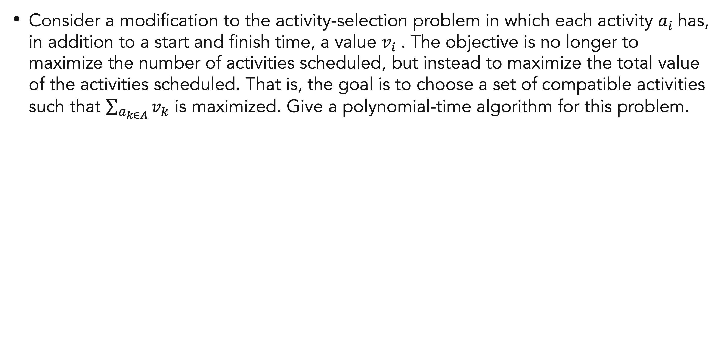
Exercises
11
Consider a modification to the activity-selection problem in which each activity $a_{i}$has, in addition to a start and finish time, a value $v_{i}$. The objective is no longer to maximize the number of activities scheduled, but instead to maximize the total value of the activities scheduled. That is, the goal is to choose a set of compatible activities such that $\sum_{a_{k∈A}}{v_{k}}$ is maximized. Give a polynomial-time algorithm for this problem.

Slide 23
References
Thomas H. Cormen. (2022). Introduction to algorithms: Fourth edition. The MIT Press. Chapter 15.

Slide 24
Thank you
Greedy methods: Activity selection problem
September, 2023

